Slide 1
Power BI
Dax hands on

Slide 2


Slide 3
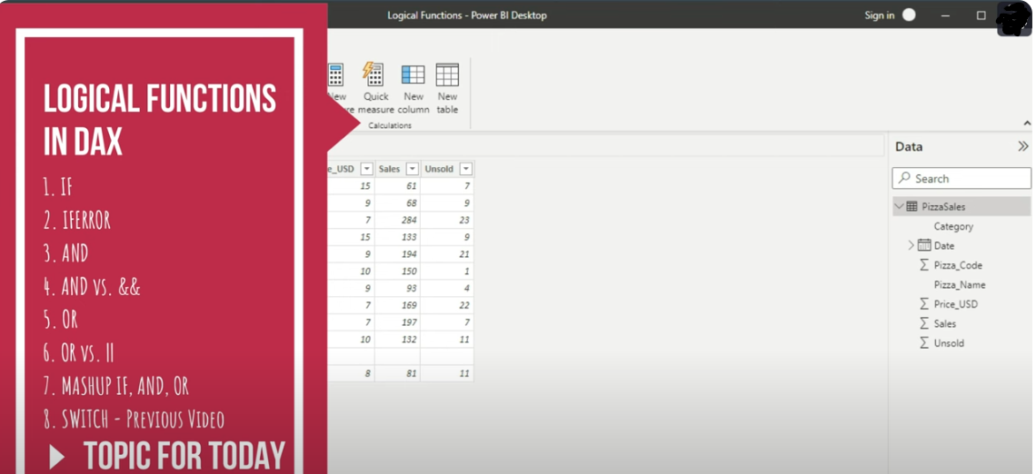

Slide 4
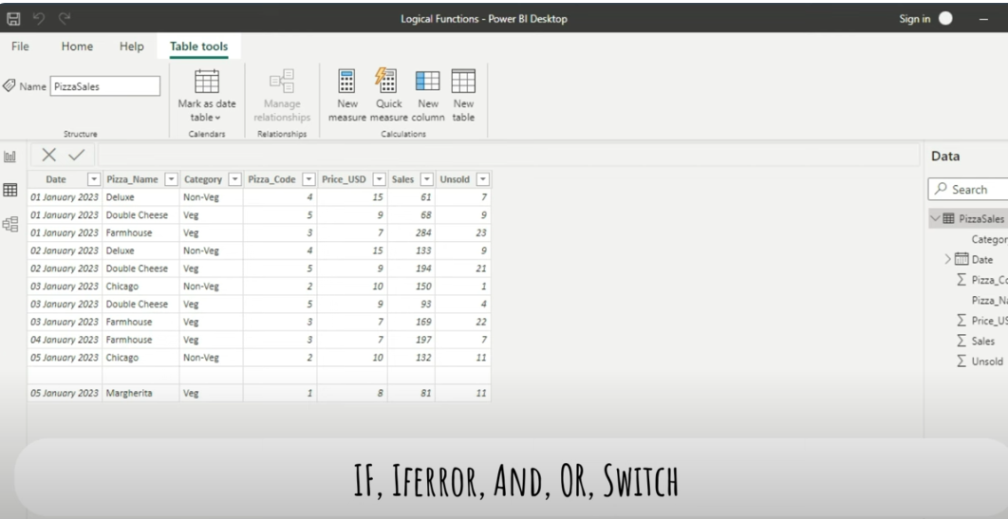
If, IfError, AND, OR, Switch

